Slide 1
SECOND – REVIEW

Slide 2

SIDDHARTH INSTITUTE OF ENGINEERING & TECHNOLOGY (AUTONOMOUS)
DEPARTMENT OF ELECTRONICS AND COMMUNICATION ENGINEERING
SECTION :– 2
BATCH NO :- 5
An Energy-Efficient Generic Accuracy Configurable Multiplier Based on Dual Sub-Adders with Error Recovery
TEAM MEMBERS:
MATAVALAM JAHNAVI 21F61A0469
DURGESAM HEMANTH KUMAR 21F61A0462
BURUGULA KANAKA DURGA PRASADU 21F61A0482
M.KARTHIK 21F61A0486
THANDLAM LOKESH 21F61A04A3
Under the esteemed guidance of :
MR.G.RAGHUL /AP/ECE

Slide 3
Abstract:
Approximate computing can decrease the design complexity with an increase in performance and power efficiency for error resilient applications. This brief deals with a new design approach for approximation of multipliers. This work proposes a generic accuracy-configurable multiplier that employs a novel dual sub-adder based approximate adder that splits a precise adder into two to significantly reduce the latency. The proposed error recovery and reduction technique effectively compensates for the catastrophic accuracy degradation incurred by the split. The proposed approximation is utilized in two variants of multipliers. Performance of the proposed multipliers is evaluated with a Xilinx 12.1.

Slide 4
Introduction:
With the growing demand for high-performance and energy-efficient computing, approximate computing has emerged as a promising solution for applications where exact computations are not always necessary. Traditional computing architectures focus on achieving high accuracy, but this often comes at the cost of increased power consumption, higher latency, and greater hardware complexity. In contrast, approximate computing introduces intentional errors in computation to improve power efficiency, performance, and area utilization, making it highly suitable for error-resilient applications such as image processing, deep learning, and multimedia processing.
Multiplication is one of the most power-hungry arithmetic operations in modern processors and digital systems. As a result, designing approximate multipliers that balance computational accuracy with efficiency has become a key research focus in low-power VLSI design. Multiplication is a fundamental operation in various applications such as digital signal processing (DSP), machine learning, cryptography, and embedded systems. Multipliers can be broadly classified into exact and approximate multipliers:

Slide 5
Introduction:
Exact Multipliers: These multipliers provide fully accurate results but suffer from high hardware complexity, power consumption, and delay.
Approximate Multipliers: These multipliers trade off a small amount of accuracy for significant improvements in speed, power efficiency, and area. They are particularly useful in applicationswhere minor errors do not significantly impact the overall system performance.
Approximate computing aligns well with low-power VLSI by simplifying arithmetic operations, reducing switching activity, and lowering overall energy dissipation . Existing approximate multipliers often suffer from severe accuracy degradation, making them unsuitable for applications requiring a balance between efficiency and precision. To address this, we propose a Generic Accuracy-Configurable Multiplier (GACM) based on a novel dual sub-adder architecture with error recovery mechanisms. The proposed design effectively reduces latency and power consumption while maintaining accuracy levels suitable for practical applications. In this work, we implement and evaluate the proposed multiplier using Xilinx 12.1 FPGA tools.

Slide 6
Motivation Behind The Project:
Need for Energy-Efficient Computing – Many applications (AI, image processing, IoT) require low-power operations with configurable accuracy.
Voltage Over Scaling (VOS) Challenges – Reducing power by lowering voltage can introduce errors, necessitating an error recovery mechanism.
Error Recovery for Reliable Computation – The system ensures that errors introduced by approximate calculations are corrected when needed.
Dual Sub-Adder Concept for Flexibility – Using two sub-adders enables configurable precision and improved energy efficiency.
Bridging the Gap Between Speed and Accuracy – Balancing computational speed, energy efficiency, and precision is crucial for modern computing applications.

Slide 7
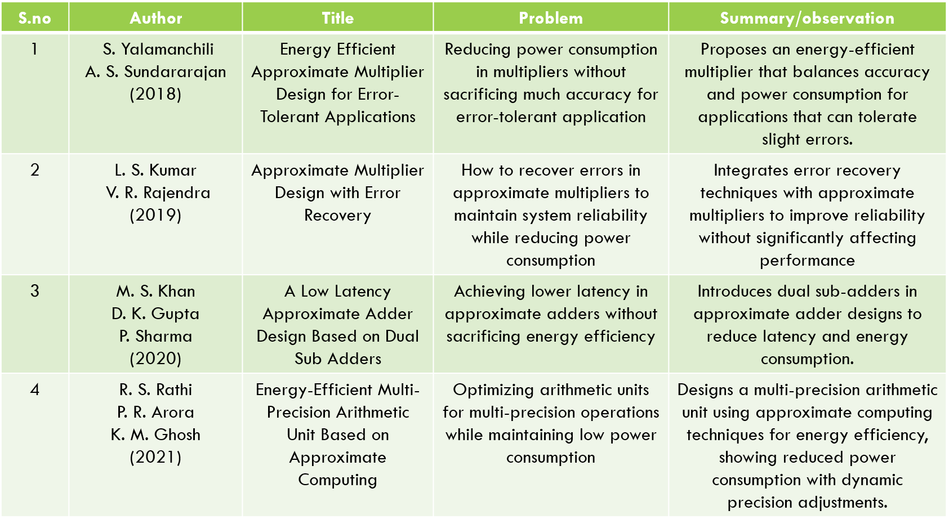
Literature Survey:

Slide 8
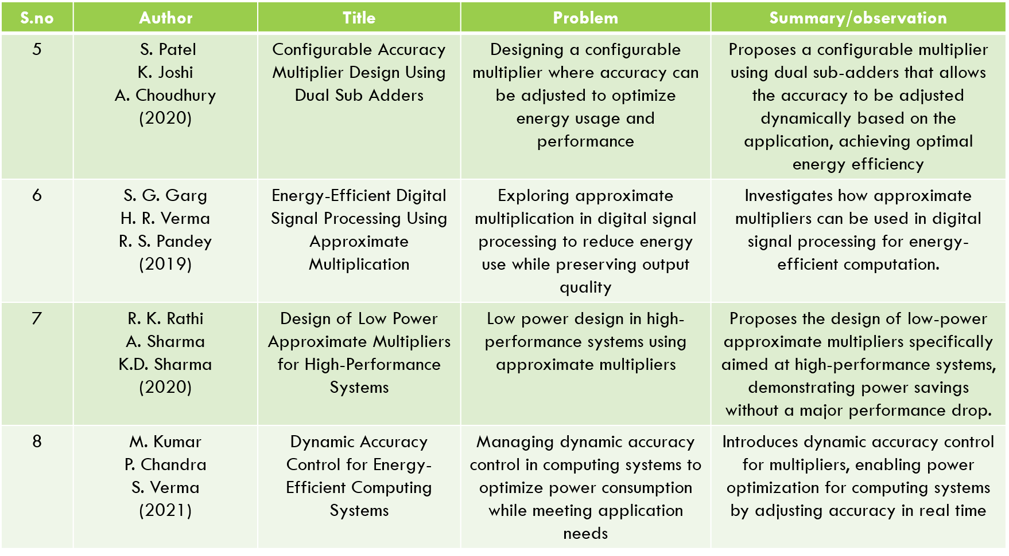
Literature Survey:

Slide 9
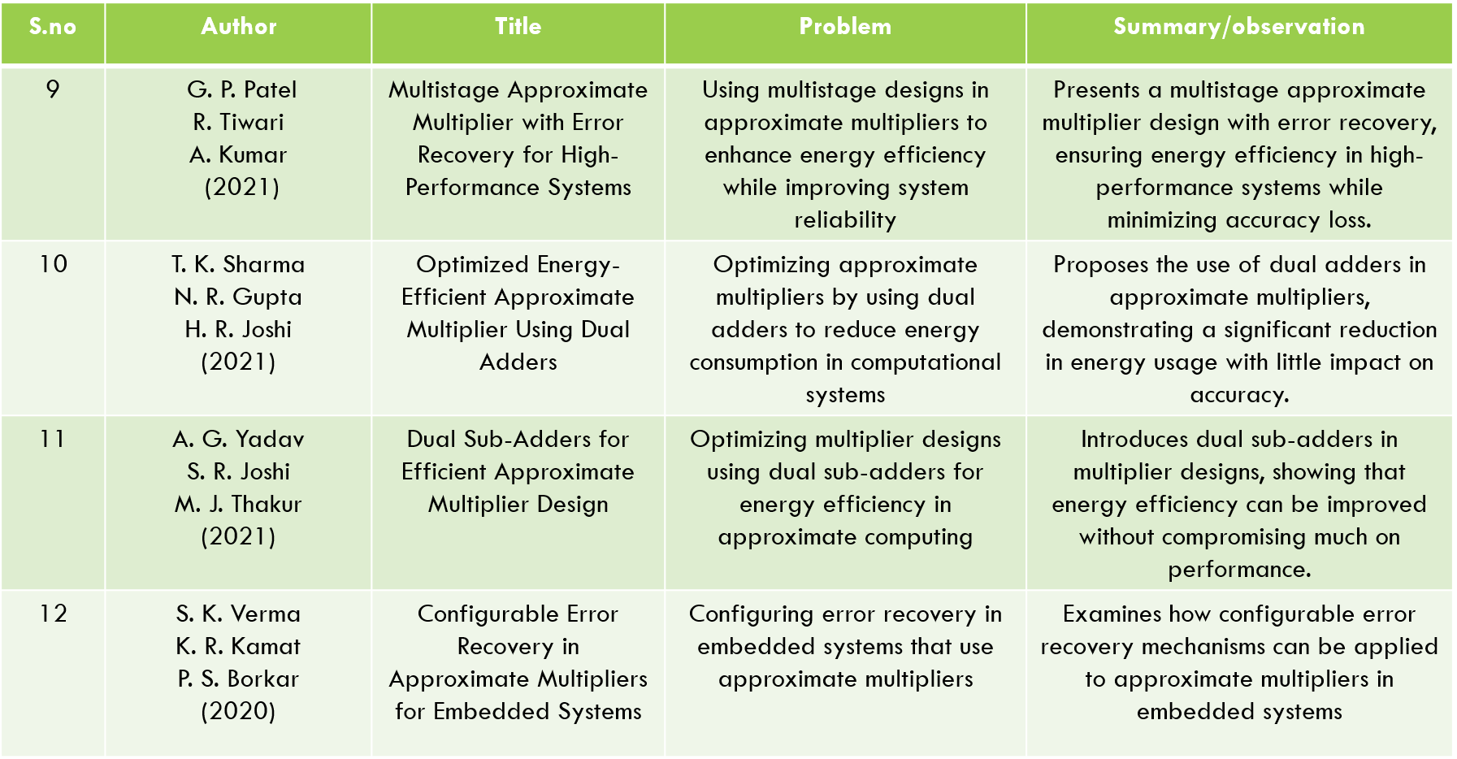
Literature Survey:

Slide 10
Objectives:
Reduce Power Consumption – Develop a multiplier that operates with lower energy requirements while maintaining computational efficiency.
Enable Voltage Over Scaling (VOS) – Reduce supply voltage dynamically to save power while compensating for potential computation errors.
Support Error-Tolerant Computing – Leverage approximate computing techniques to achieve higher performance with minimal impact on output quality
Implement Accuracy Configurability – Allow dynamic adjustment of precision to balance energy efficiency and computational accuracy.
Develop a Low-Power Circuit Architecture – Minimize the number of transistors and logic gates required to implement the design, reducing area and energy consumption.

Slide 11
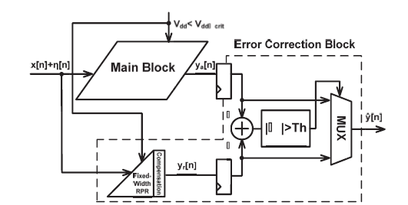
Existing System:
DACA- Dynamic Accuracy-Configurable Adders For Energy-Efficient Multi-Precision Computing
No accuracy adjustment, high power consumption
Inefficient for applications that tolerate small inaccuracies
No built-in error Recovery
No flexibility in precision; power is wasted on unnecessary accuracy.
Lack of configurability leading to inefficiency

Slide 12
Existing System:
Draw backs
1. Accuracy vs. Power Trade-off
While the design allows configurable accuracy, reducing accuracy can lead to incorrect results in some applications, especially those requiring high precision.
2. Increased Complexity
The use of dynamic accuracy control and multiple precision levels adds design complexity.
3. Area Overhead
Additional circuitry for error recovery and accuracy configuration can increase the area footprint on the FPGA or ASIC.
4. Latency Issues
The dynamic switching mechanism and error correction introduce additional delay.
5. Energy Overhead in Certain Cases
While energy efficiency is a goal, the additional logic for error detection and correction may consume extra power in some configurations.

Slide 13
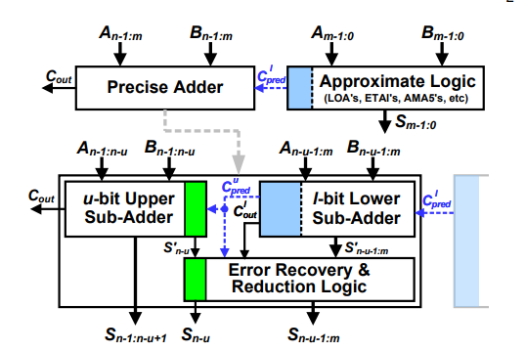
Proposed System:
An Energy-Efficient Generic Accuracy Configurable Multiplier Based on Dual Sub-Adders with Error Recovery
Accuracy-configurable multiplier based on dual sub-adders
Reduces power consumption
Improves overall system performance
Adapts to application-specific accuracy needs
Incorporates voltage over scaling (VOS) for energy savings.
Built-in error recovery to maintain acceptable accuracy

Slide 14
Proposed System:
GACM Working Mechanism
GACM improves upon this standard method by dividing the multiplication into two approximate sub-multiplications and using an error recovery mechanism.
🔹 Step 1: Divide the Multiplication into Two Parts
GACM splits the multiplication into:
High-precision part (Most Significant Bits - MSB)
Low-precision part (Least Significant Bits - LSB)
If we have two 8-bit numbers, we divide them into two 4-bit sections:
A=(AH×24)+ALA = (A_H \times 2^4) + A_LA=(AH​×24)+AL​ B=(BH×24)+BLB = (B_H \times 2^4) + B_LB=(BH​×24)+BL​
🔹 Step 2: Perform Approximate Multiplications
The multiplication of A×BA \times BA×B is broken down into:
A×B=(AH×BH)×28+(AH×BL+AL×BH)×24+(AL×BL)A \times B = (A_H \times B_H) \times 2^8 + (A_H \times B_L + A_L \times B_H) \times 2^4 + (A_L \times B_L)A×B=(AH​×BH​)×28+(AH​×BL​+AL​×BH​)×24+(AL​×BL​) Instead of calculating all terms precisely, GACM:
Uses approximate adders for low-precision parts.
Uses energy-efficient truncated multiplication for low-significant bits.
Uses exact multiplication for high-significant bits.
This reduces the number of logic operations, saving power.
🔹 Step 3: Error Recovery Mechanism
After performing approximate multiplication, GACM estimates the error and applies a correction step to improve accuracy.
The error correction logic dynamically adjusts the final result by compensating for approximation errors in the LSB section.
This helps balance power efficiency and accuracy.

Slide 15
Block Diagram:

Slide 16
Software Details:
Virtual box
Xilinx 12.1

Slide 17
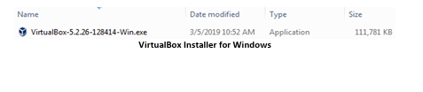
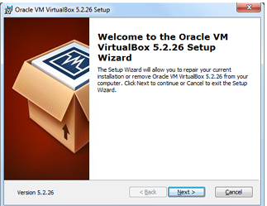
Software Details:
Download VirtualBox From The Site
Link: https://www.virtualbox.org/wiki/ Downloads
Launch the VirtualBox installer from Windows Explorer by double-clicking the self-extracting executable. Allow the installer to make changes to your computer, if so prompted.
Once the VirtualBox installation wizard appears, click the Next button.

Slide 18
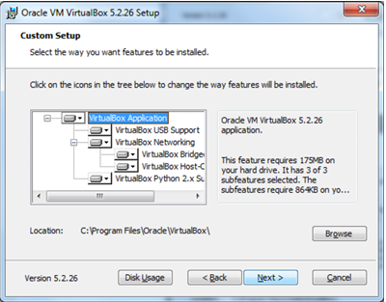
Software Details:
You may accept all the installation defaults, although you may wish to change the installation location on your development platform using the Browse button. If the options are acceptable, click the Next button

Slide 19
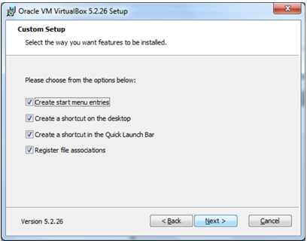
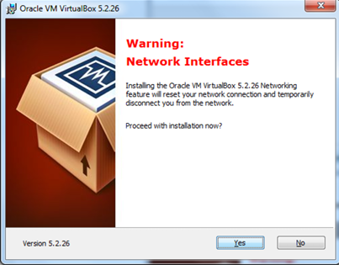
Software Details:
You may again accept the default options and click the Next button.
Click the Yes button to continue with the installation wizard.

Slide 20
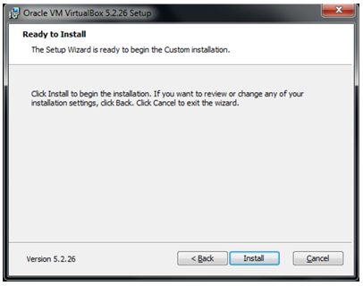
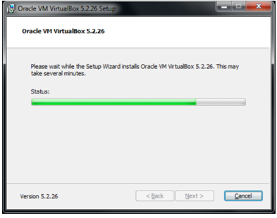
Software Details:
Click the Install button to load VirtualBox to your development system.
During the installation you may receive prompts to authorize installation of various components. If prompted, allow the installer to make changes to your system, including installation of the USB interface and Network adapters.

Slide 21
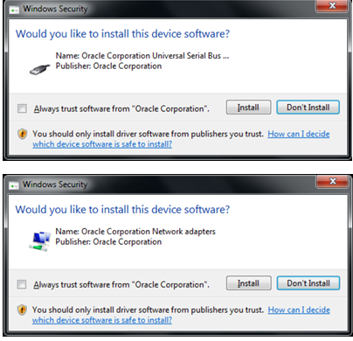
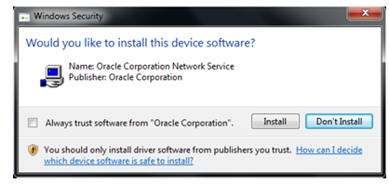
Software Details:
If you are asked to install the Oracle Corporation Universal Serial Bus device driver, or Oracle Corporation Network Adapters/Network Service, choose to install them

Slide 22
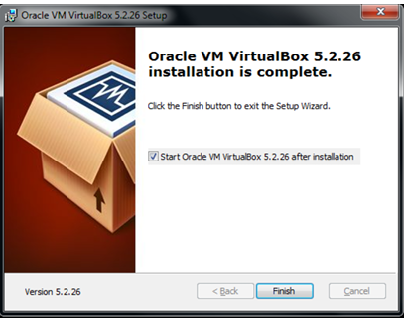
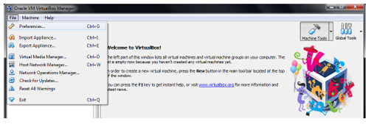
Software Details:
Click the Finish button to complete the installation. Leave the checkbox enabled so VirtualBox will start after the installer finishes.
Once VirtualBox starts (you can also start it from the Desktop shortcut, or the Windows Start button), the Extension Pack must be added. From the main menu, select File > Preferences.

Slide 23
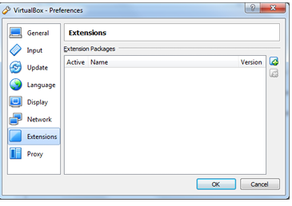

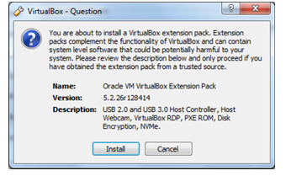
Software Details:
Select Extensions. Right-click in the Extension Packages whitespace box and select Add Package
Browse to the location where you downloaded the VirtualBox Extension Pack compatible with your VirtualBox version. Select the Extension Pack and click the Open button.
Click the Install button to add the VirtualBox Extension Pack.

Slide 24
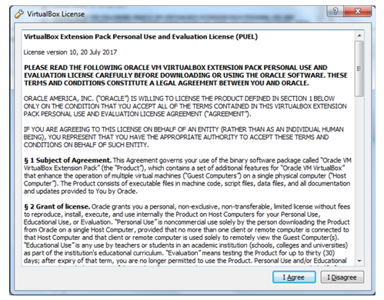
Software Details:
Read the VirtualBox Extension Pack PUEL License to ensure you will not be in violation of the Oracle definition of Personal Use. See the VirtualBox Licensing Frequently Asked Questions for additional details. If you can accept the license conditions, scroll to the bottom of the agreement text box and click the I Agree button1. If prompted, allow the installer to make changes to your development system.

Slide 25
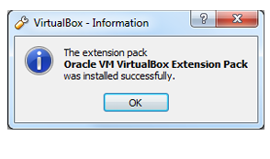
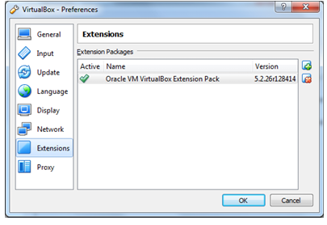
Software Details:
Click the OK button to complete the installation.
Click the OK button to return to VirtualBox.
This completes the installation of VirtualBox on your host development system. VirtualBox is now ready to accept a new Virtual Machine.

Slide 26
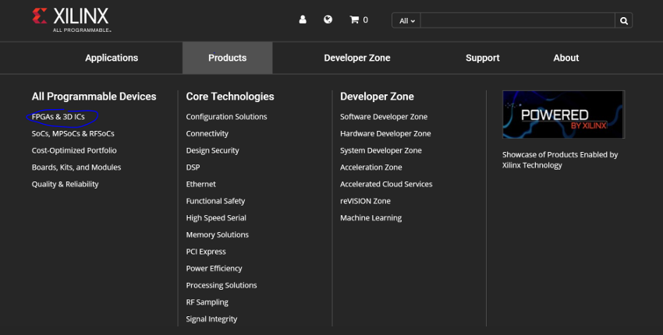
Software Details:
Download Xilinx ISE From The Site
https://www.xilinx.com/support/download/index.html/content/xilinx/en/downloadNav/design-tools/14_7-windows.html

Slide 27

Software Details:
Whether you are a Mac or Windows user, download the compressed file. (Despite, if you on Mac, the fact that the download says “windows”) You may need to create an account with Xilinx and provide a company, I just used the campus address and contact info. If that works, skip the next slides and proceed to either “Windows Install” or “Mac Install”
Navigate to Xilinx’s Products listing, and look for the product page for the “Spartan 6”

Slide 28
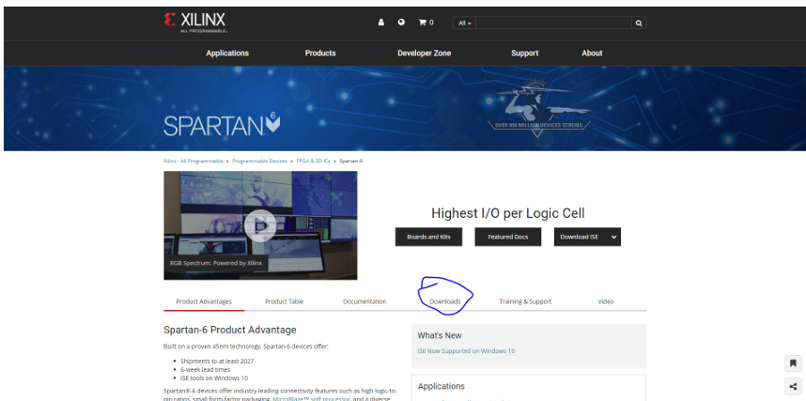
Software Details:
Look for the associated downloads tab

Slide 29
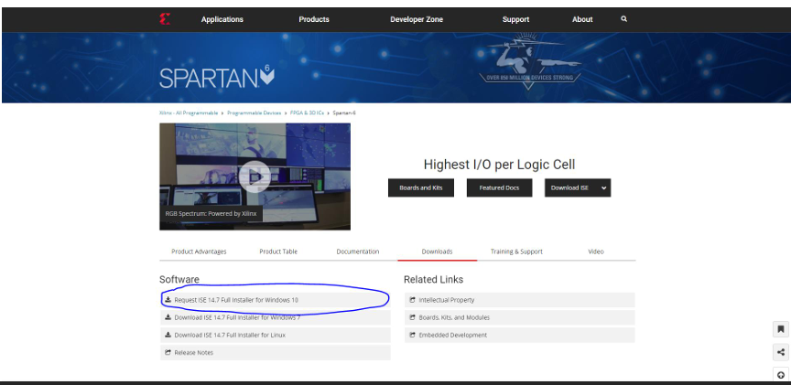
Software Details:
Look for the Windows 10 Installer compressed download (tar or zip)
Note: even if you are installing for Mac, we will use the Windows 10 install files

Slide 30
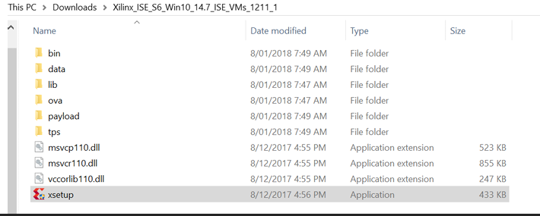
Software Details:
Installing Xilinx In Virtual Box
Just unzip the installer and click “xsetup”
• It’s pretty straightforward, but there’s a couple options that you might want to pay attention to (see next two slides before install)

Slide 31
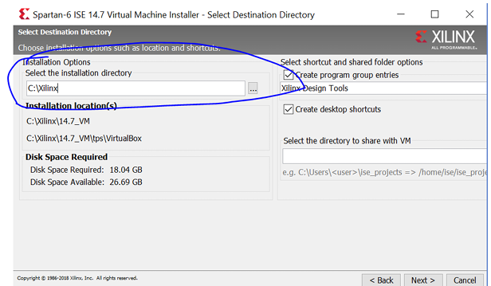
Software Details:
Installer – File Location
At this stage, you can select the install directory. Xilinx takes up a large swath of memory so it’s a good idea to set this to a bigger hard drive

Slide 32
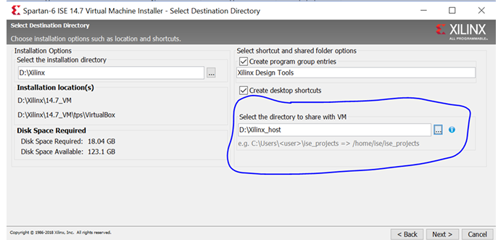
Software Details:
Installer – Shared Folder
You can set up a folder to be visible from both your (host) operating system and the virtual machine’s (guest) operating system. This is good for quickly moving files around. (See Usage Notes)

Slide 33
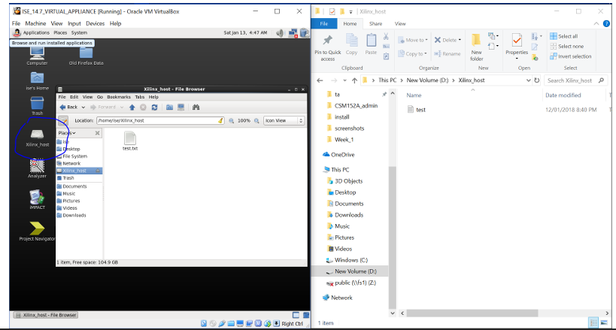
Software Details:
Shared Folder
The shared folder in the VM should have a desktop shortcut
If you forgot to do this in the installer, you can create a new shared folder following the Mac instructions for a shared folder later in these slides.

Slide 34
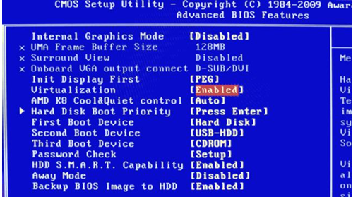
Software Details:
Additional Setup
• You may need to enable hardware virtualization on your computer
• For that, you will need to restart and enter the BIOS and find the setting “virtualization” and enable it

Slide 35
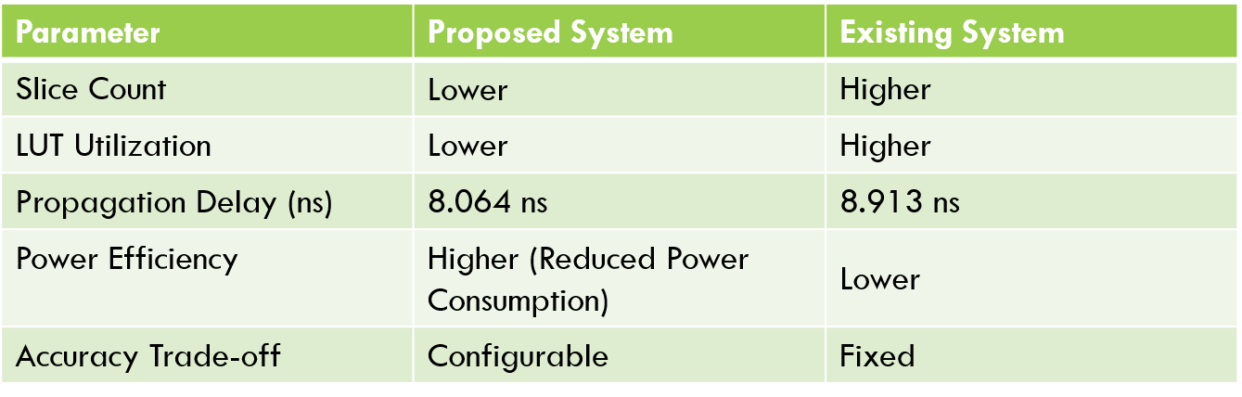
Result & comparison table:
The results of this project focus on evaluating the performance improvements of the proposed Generic Accuracy-Configurable Multiplier (GACM) with a dual sub-adder architecture and error recovery mechanism. Based on FPGA simulations using Xilinx ISE 12.1

Slide 36
Limitations:
1. Trade-off Between Accuracy and Power Efficiency
While the design offers configurable accuracy, higher accuracy settings may reduce energy savings.
The error recovery mechanism may introduce additional latency and power overhead in some cases.
2. Hardware Complexity
The dual sub-adder architecture adds design complexity, making implementation more challenging compared to conventional multipliers.
Increased circuit area may limit applicability in resource-constrained embedded systems.
3. Performance in High-Speed Applications
The design might not be as fast as fully parallel multipliers, making it less suitable for ultra-high-speed applications like high-frequency trading or advanced DSP applications.
Some delay overhead may arise due to error recovery and accuracy reconfiguration.
4. Scalability Issues
Scaling the design to very large bit-width operations (e.g., 64-bit or higher) may lead to increased propagation delays and power consumption.
Effectiveness in massively parallel architectures (e.g., GPUs) is yet to be fully explored.
5. Application-Specific Constraints
The multiplier may not be suitable for mission-critical applications (e.g., aerospace, cryptography) that require 100% accuracy at all times.
Some applications may require fixed-precision arithmetic, reducing the benefit of accuracy configurability.

Slide 37
Applications:
Low-Power IoT Devices – Enables efficient data processing in battery-powered IoT sensors and edge computing applications.
Autonomous Systems & Robotics – Helps in efficient real-time processing for object detection, motion planning, and AI-driven decision-making.
Neural Networks & Deep Learning – Optimizes multiplication operations in neural network training and inference for faster, energy-efficient computations.
Wireless Communication Systems – Improves efficiency in error-tolerant computations like modulation, demodulation, and encoding in 5G and other communication technologies.
Image & Video Processing – Allows configurable accuracy for tasks like image filtering, compression, and enhancement, saving energy in multimedia applications.

Slide 38
Conclusion:
In conclusion, this work presents an innovative design for an accuracy-configurable approximate multiplier aimed at enhancing power efficiency and performance in error-resilient applications. By introducing a novel dual sub-adder based approximate adder, the system effectively reduces latency and hardware complexity, making it well-suited for real-time, low-power applications such as image processing, signal processing, and machine learning. The proposed error recovery and reduction technique successfully mitigates the accuracy loss introduced by the approximation, enabling the multiplier to deliver reliable results even in scenarios where a high degree of precision is not critical.The system's adaptability is further enhanced by the inclusion of two multiplier variants, each optimized to balance accuracy and performance for different application requirements. Extensive evaluation using Xilinx 12.1 confirms that the proposed multiplier meets its design goals, achieving significant improvements in speed and power efficiency over traditional precise multipliers. Overall, this work contributes to the field of approximate computing by providing a practical, configurable solution for applications where power and speed are prioritized over exact precision. Future research may explore further refinements in error recovery and adaptive configuration to enhance the multiplier’s versatility in a wider range of computational contexts.

Slide 39
Future Scope:
1. Optimization for Emerging Technologies
Implementing the design on advanced process nodes (e.g., 5nm, 3nm) to further improve power efficiency.
Exploring low-power FPGA and ASIC implementations for real-world applications.
2. Integration with AI and Machine Learning
Enhancing the multiplier for deep learning accelerators where configurable accuracy can improve efficiency.
Utilizing it in edge AI devices to balance performance and power consumption dynamically.
3. Application in High-Performance Computing (HPC)
Adapting the design for parallel computing architectures to boost efficiency in scientific and cryptographic computations.
Integrating with quantum-inspired computing for hybrid precision calculations.
4. Extension to Approximate Computing
Enhancing approximate computing techniques by introducing adaptive error recovery mechanisms.
Applying the design in energy-aware IoT devices where lower power consumption is critical.
5. Security and Reliability Improvements
Investigating fault-tolerant mechanisms to enhance reliability in safety-critical applications like aerospace and healthcare.
Exploring the use of hardware security techniques to prevent vulnerabilities in cryptographic applications.

Slide 40
Reference:
P. Kulkarni, P. Gupta, and M. D. Ercegovac, “Trading accuracy for power in a multiplier architecture,” J. Low Power Electron., vol. 7, no. 4,pp. 490–501, 2011.
C.-H. Lin and C. Lin, “High accuracy approximate multiplier with error correction,” in Proc. IEEE 31st Int. Conf. Comput. Design, Sep. 2013, pp. 33–38.
C. Liu, J. Han, and F. Lombardi, “A low-power, high-performance approximate multiplier with configurable partial error recovery,” in Proc. Conf. Exhibit. (DATE), 2014, pp. 1–4.
R. Venkatesan, A. Agarwal, K. Roy, and A. Raghunathan, “MACACO: Modeling and analysis of circuits for approximate computing,” in Proc. IEEE/ACM Int. Conf. Comput.-Aided Design (ICCAD), Oct. 2011, pp. 667–673.
J. Liang, J. Han, and F. Lombardi, “New metrics for the reliability of approximate and probabilistic adders,” IEEE Trans. Comput., vol. 63, no. 9, pp. 1760–1771, Sep. 2013

Slide 41
Reference:
H. Waris, C. Wang and W. Liu, "Hybrid Low Radix Encoding-Based Approximate Booth Multipliers," in IEEE Transactions on Circuits and Systems II: Express Briefs, vol. 67, no. 12, pp. 3367-3371, Dec. 2020, doi: 10.1109/TCSII.2020.2975094.
M. Zhang, S. Nishizawa and S. Kimura, "Area Efficient Approximate 4–2 Compressor and Probability-Based Error Adjustment for Approximate Multiplier," in IEEE Transactions on Circuits and Systems II: Express Briefs, vol. 70, no. 5, pp. 1714-1718, May 2023, doi: 10.1109/TCSII.2023.3257852.
W. Liu, T. Zhang, E. McLarnon, M. O’Neill, P. Montuschi and F. Lombardi, "Design and Analysis of Majority Logic-Based Approximate Adders and Multipliers," in IEEE Transactions on Emerging Topics in Computing, vol. 9, no. 3, pp. 1609-1624, 1 July-Sept. 2021, doi: 10.1109/TETC.2019.2929100.
Z. Aizaz and K. Khare, "Area and Power Efficient Truncated Booth Multipliers Using Approximate Carry-Based Error Compensation," in IEEE Transactions on Circuits and Systems II: Express Briefs, vol. 69, no. 2, pp. 579-583, Feb. 2022, doi: 10.1109/TCSII.2021.3094910.

Slide 42
Expected Output:
Configurable accuracy multiplier working successfully.
Error detection & recovery mechanism implemented.
Power consumption reduced compared to traditional multipliers.
FPGA synthesis and timing constraints met.
Simulation results verify correct functionality.
Example Calculation for Expected Output:
Multiplication Example: 23 × 45
Full-Accuracy Mode (16-bit multiplication)
Exact Calculation: 23 × 45 = 1035
Output: 1035 (Exact Result)
Low-Accuracy Mode (8-bit approximation)
Approximated Calculation: (Rounded to 20 × 40 = 800)
Output: ~800 (Reduced accuracy but lower power consumption)
Error Recovery Check If the error is detected (>5% deviation), a correction step is applied.
Adjusted Output: 1030 (After error correction)

Slide 43
Expected Output:
Full Accuracy Mode → Produces a result identical to a traditional multiplier.
Reduced Accuracy Mode → Produces an approximate result with lower power consumption.
The output may have slight errors in reduced accuracy mode, depending on the error tolerance level.
Example: If the inputs are:
A = 13 (Binary: 1101) B = 7 (Binary: 0111)
Full Accuracy Mode Output: 91 (Binary: 1011011)
Reduced Accuracy Mode Output: Approximate value (e.g., 89 or 92, depending on the error model).
Accuracy Mode | Expected Output | Error Recovery
Full Accuracy | Exact product (A × B) | Not needed
Reduced Accuracy | Approximate product (A × B ± small error) | Applied if required
Error Recovery Applied | Corrected product (closer to A × B) | Improves accuracy

Slide 44
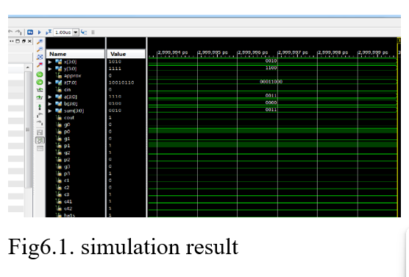
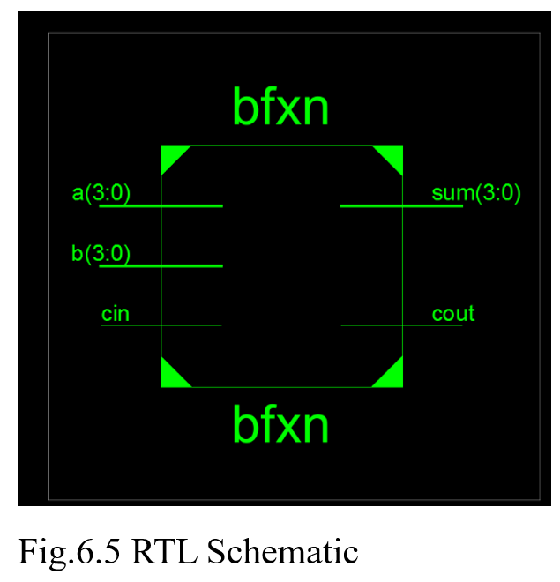
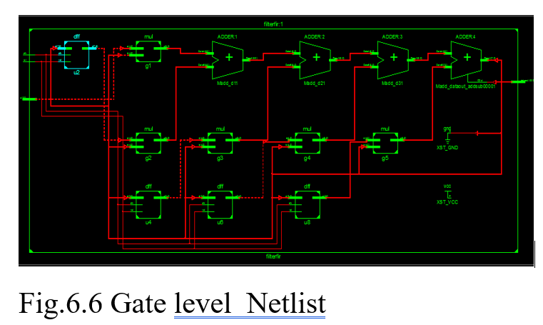
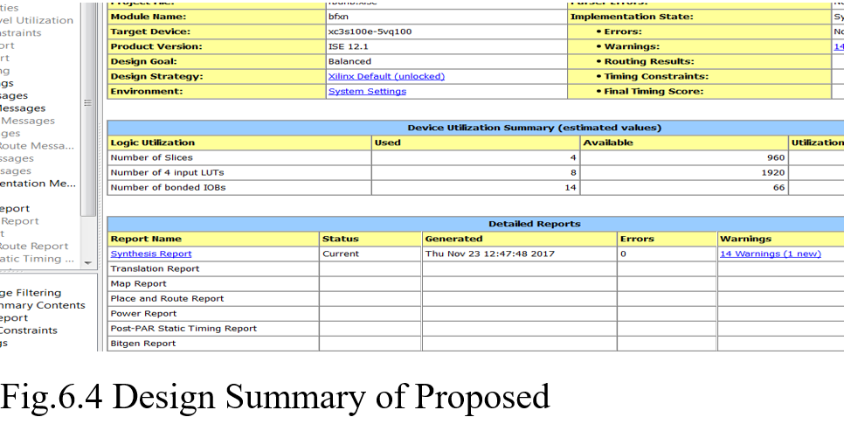
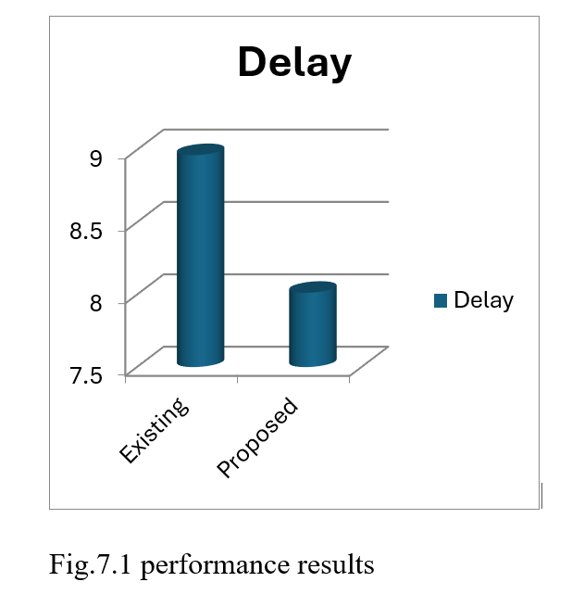
Expected Output Wave forms:

Slide 45
THANK– YOU

